Slide 1
UNIT THREE: Theory of Consumer Behavoir (Utility Theory)
Rabindra Bista
College of Applied Business (CAB)

Slide 2
Meaning of Utility
The term utility refers to the human want satisfying power of the commodity.
It is the subjective entity and can vary from person to person, time to time and place to place
We can create or add utility by the following four functions: a) by changing time b) by changing place c) by changing form d) by changing person.

Slide 3
Modern economists had criticized the concept of cardinal measurement of utility and argued that utility is psychological thing rather than quantitative thing; therefore utility can’t be presented numerically but can be presented in order or can be ranked.
By consuming two units of apple, we can’t say that, I got ten utils of utility but can say that 1st unit of apple had more utility than 2nd unit of apple.
Indifference curve analysis is the example of this approach. It was first used by F.Y.Edgeworth in 1881 AD.

Slide 4
Cardinal and Ordinal Utility approach
Classical and neo-classical economists like H.H.Gossen, A. Marshall, L. Walaras etc. believed that utility is quantitative thing and can be measured numerically and its unit of measurement is utils.
The initial contributor of the cardinal approach was H.H.Gossen, because he propounded the laws like law of diminishing marginal utility, law of substitution etc. in 1854 AD.
Another main contributor of this approach was A. Marshall because he further popularized those laws as well as this cardinal measurement approach of utility.
Cardinal approach is based on the assumptions like: rationality, numerical measurement of utility, budget constraint, constant marginal utility of money etc.

Slide 5
Differences between Cardinal and Ordinal Approaches
The basic differences between cardinal and ordinal utility approaches are as follows;
Measurement of utility
Addition of utility
Express the preference/Observation of preference
Combination of goods
Applicability of the approach
Assumptions of the approach etc.

Slide 6
Types of Utility
There are three types of utility :
1. Total utility (TU) :
Total satisfaction obtained by the consumer from consuming all the available units of the commodity is called total utility. It is the sum total of all the marginal utilities associated with each and every unit of consumption.
Mathematically,
TU = Σ MU
Or, TU = MU₁ + MU₂ +MU₃ +…………..+MU_{n}
Where, TU = Total utility
MU₁= Marginal utility obtained from 1st unit of consumption.(so on…)

Slide 7
2. Average utility (AU) :
Utility per unit derived from consumption of given units of the commodity is called average utility. In other words it is the outcome of total utility divided by units of commodity consumed.
Mathematically,
AU = TU/Q
Where, TU = Total Utility ,
Q = Units of commodity.
3. Marginal utility (MU):
MU is the addition made to Total utility with consumption of one extra unit of the commodity. In other words, it is the ratio of change in total utility with the change in units of commodity (normally one).
Mathematically,
MU = ΔTU/ ΔQ Where, ΔTU = change in Total utility
ΔQ = change in units.
Alternatively,
MU = TU_{n} – TU_{n-1} Where, TU_{n}= Total utility of n^{th} unit,
TU_{n-1}= Total utility of n-1th unit of consumption

Slide 8
Indifference Curve Analysis
BACKGROUND
It is based on Ordinal utility approach.
First used by F.Y.Edgeworth in 1881 AD, to show the possibility of exchange between products and factors between two persons efficiently.
Irving Fisher also used the concept of ordinal utility approach in 1892 AD.
V. Pareto explained his theory ‘Pareto Optimality’ by using this ordinal approach in 1906 AD.
U. Slutsky also used this concept in 1915 AD.
Formally, two economists J.R.Hicks and R.G.D.Allen developed the concept of Indifference Curve in 1934 AD.
Again revised by Hicks in 1939 in his book “Value and Capital”

Slide 9
Meaning Of Indifference Curve
Indifference curve is the locus of different combinations of two commodities X and Y, from which the consumer yields equal level of satisfaction.
The consumer will be indifferent among all the combinations of that curve.
Also called as iso-utility curve or equal satisfaction curve.

Slide 10
Assumptions of Indifference Curve
Utility can’t be presented numerically but can be presented in order.
The consumer is rational .
Two wants are satiable at a time.
Total utility of consumer depends on the units of commodities.
Consumer is consistent in his choice.
Consumer’s choice are characterized by transitivity. (if A>B, B>C then A>C)
Consumer has non-satiety nature.
The consumer has scale of preferences.
There is operation of law of diminishing marginal rate of substitution.

Slide 11
Derivation of IC
IC can be derived by using Consumer’s indifference schedule as following:
Consumer’s indifference schedule can be defined as the tabular presentation of various combinations of two commodities which are equally acceptable to the consumer or which give equal level of satisfaction.
Prof. Watson, “An indifference schedule is a list of combinations of two commodities, the list being so arranged that a consumer is indifferent to the combinations, preferring none of any others.”

Slide 12
Consumer's Preference Schedule:
Combinations | Units of X | Units of Y | MRS_{XY}
A | 1 | 20 | -
B | 2 | 15 | 5:1
C | 3 | 11 | 4:1
D | 4 | 8 | 3:1
E | 5 | 6 | 2:1
F | 6 | 5 | 1:1

Slide 13
Indifference Curve
IC

Slide 14
Indifference Map
If two or more Indifference curves are presented in same graphical illustration it is called as indifference map. Indifference map describes all the combinations of consumer’s preferences. In an indifference map higher indifference curve shows higher level of satisfaction.
Units of Y
IC1
IC2
Units of X

Slide 15
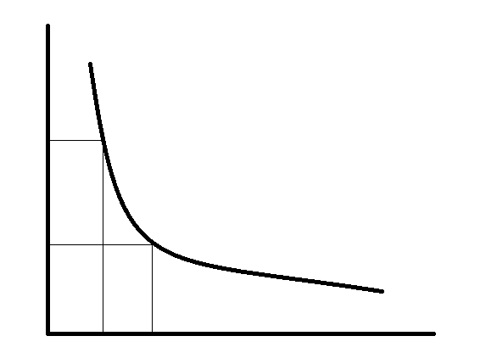
Properties of Indifference Curve
IC always slopes downwards from left to right.
Units of Y
It is due to non-satiety nature of the consumer i.e. the consumer prefers more goods to less of it.
To maintain the same level of satisfaction if the consumer gains some utility from X, he must loose some utility from Y i.e. if the consumer increases the units of X, he must sacrifice some units of Y.
It means there is inverse relationship between the units of X and the units of Y. so, IC is sloping downwards from left to right.
A
Y₁
B
Y₂
IC
O
X₁
X₂
Units of X

Slide 16
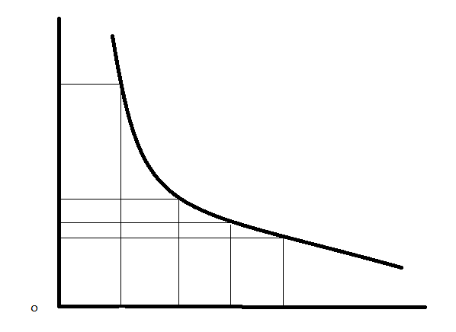
2) IC is convex towards the origin.
Units of Y
It is due the operation of law of diminishing MRS, if IC is concave it MRS will be increasing and if, IC is straight line MRS will be constant.
Here,
MRSxy at AB = Aa/aB
MRSxy at BC = Bb/bC
MRSxy at CD = Cc/cD
Since, Aa>Bb>Cc and aB = bC = cD
MRSxy at AB >MRSxy at BC >MRSxy at CD
Therefore, MRSxy is decreasing. So, IC is convex towards the origin.
Y₁
A
B
Y₂
a
C
Y₃
b
D
Y₄
c
IC
X₁
X₂
X₃
X₄
Units of X

Slide 17
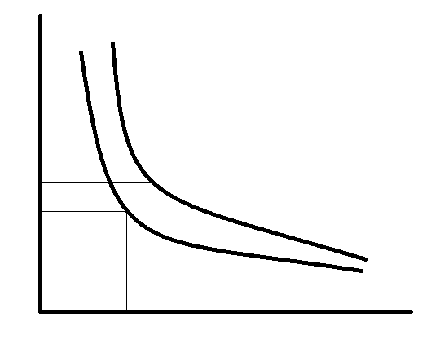
3) Higher IC yields higher level of satisfaction.
We know that, U = f(X, Y)
In lower IC₁, A (X₁, Y₁)
In Upper IC₂, B (X₂, Y₂)
Since, X₂ >X₁ and Y₂ >Y₁
Utility at B >Utility at A
So, IC₂ gives higher level of satisfaction than IC₁
Units of Y
B
Y₂
A
Y₁
IC₂
IC₁
O
X₁
X₂
Units of X

Slide 18
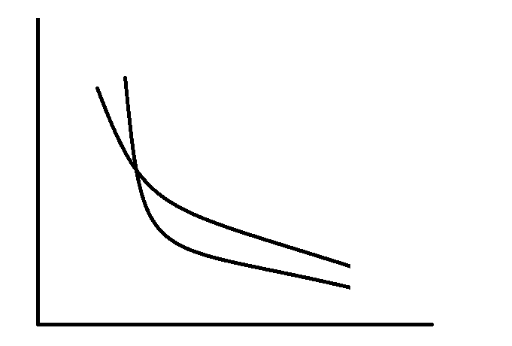
4) ICs Never intersect with each other.
It is due to the 3rd property of IC i.e. higher IC gives higher level of satisfaction.
If ICs intersect, higher and lower ICs give same level of satisfaction.
Units of Y
In the given diagram,
In IC₁, Utility at A = Utility at E………………(1)
In IC2, Utility at B = Utility at E………………(2)
Hence, from …………(1) and ………(2)
Utility at A = Utility at B
Which is not possible because at points A and B, IC2 is higher than IC1 or Utility at B> Utility at A
Therefore, ICs never intersect with each other.
E
B
A
IC₂
IC₁
O
Units of X

Slide 19
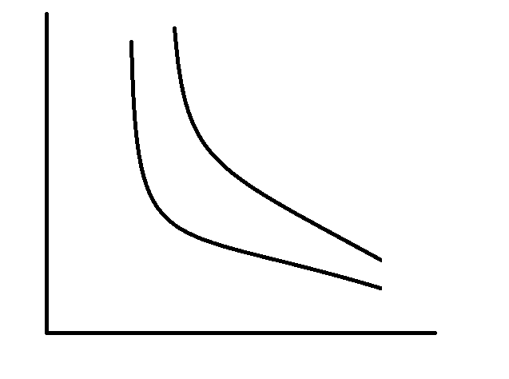
5) ICs need not to be parallel with each other.
It is because MRS may differ for different ICs or rate of sacrifice for different consumers may differ even if commodity X is preferable than Y for both of them.
MRS is also the slope of IC. If MRS differs, slope of IC also differs. Hence ICs may not be parallel to each other.
But it doesn’t mean that ICs never parallel to each other.
Units of Y
IC₂
IC₁
O
Units of X

Slide 20
The law of diminishing MRS
Concept of MRS:
MRS can be defined as the units of a commodity which must be sacrificed to increase one extra unit of the commodity so that the level of satisfaction or utility remains constant. MRS_{XY} represents the amount of Y which the consumer is ready to sacrifice for the gain of one additional unit of X. so that, his level of satisfaction remains same. In other words, MRS_{XY} is the ratio of change in units of Y goods with the change in units of X goods. It is also the slope of the Indifference curve.

Slide 21
Let the consumer only consumes two commodities X and Y, in which X is preferable than Y, so the consumer will increase the units of X by sacrificing the units of Y.
Total utility of consumer depends on the units of X and Y
U = f(X,Y)
If the consumer increases the units of X by ΔX, with marginal utility MU_{X} , gain in total utility by the consumer is , ΔX. MUx………………(1)
For this the consumer will sacrifice the units of Y, if the sacrificed units of Y is ΔY, with marginal utility MUy, loss in total utility by the consumer is , - ΔY. MUy
In that process the consumers utility remains unchanged ,
i.e . Total utility gain = total utility loss
ΔX. MUx = - ΔY. MUy
- ΔY/ ΔX = MUx/MUy
MRS_{XY} = - MU_{X}/MU_{Y}

Slide 22
Graphically,
Units of Y
Here,
MRSxy at AB = Aa/aB
MRSxy at BC = Bb/bC
MRSxy at CD = Cc/cD
Since, Aa>Bb>Cc and aB = bC = cD
MRSxy at AB >MRSxy at BC >MRSxy at CD
Therefore, MRSxy is decreasing.
Y₁
A
B
Y₂
a
C
Y₃
b
D
Y₄
c
IC
X₁
X₂
X₃
X₄
Units of X

Slide 23
Causes of Law of Diminishing MRS
The want for a particular good is satiable at a time (when a consumer has more and more of a good, the intensity of his want for that good goes on declining.)
Goods can’t be perfectly substitutable.
(if two goods are perfectly substitutable MRS remains constant and equal to one.)
Increase in quantity of good does not increase the want satisfying power of the other.

Slide 24
Budget line /Price Line:
Budget line is also a locus of different combinations of two commodities X and Y which yields equal expenditure of the consumer or which can be purchased by using the fixed income/budget of the consumer.
In two commodity model, budget constraint of the consumer can be expressed as,
Px .X + Py .Y = B
Let, B = Rs1000, Px = 10, Py = 20
Then , X = 0, Y = 1000/20 = 50
When , Y = 0 , X = 1000/10 = 100
The combinations of X and Y are A(0,50) and B(100,0)
By Plotting those points in X-axis and Y-axis we get a straight line joining two axes, which is called as price line/budget line. Which shows equal money expenditure of the consumer.

Slide 25
Graphically,
Combination | Units of X @ 10 /unit | Units of Y @20/unit | Expenditure
A | 0 | 50 | 1000
C | 20 | 40 | 1000
D | 40 | 30 | 1000
E | 60 | 20 | 1000
F | 80 | 10 | 1000
B | 100 | 0 | 1000
Units of Y
A (0,50)
50
C (20,40)
40
30
D (40,30)
20
E (60,20)
F (80,10)
10
B (100, 0)
O
20
40
60
80
100
Units of X

Slide 26
Shift of Budget Line:
Budget line shifts due to the following two reasons:
A) Due to change in total budget of the consumer.
In this case budget line shifts parallelly from its original position. If consumer’s budget increases budget line shifts upwards and if budget decreases budget line shifts downwards.
As for example, in the above case if consumer’s budget increases to 2000, then …….
If Budget reduces to 500, then………..

Slide 27
Graphically,
Units of Y
A’’
100
A
50
@ 2000
@ 1000
25
A’
@ 500
B’
B
B’’
O
50
100
200
Units of X

Slide 28
B) Due to change in Price of commodities
When price of commodities change, budget line will swing only in that axis in which the price changed commodity is expressed. If price of commodity increases, budget line will swing towards the origin and if price of commodity decreases budget line will swing away from origin.

Slide 29
a) Change in Price of X
b)Change in Price of Y
Units of Y
Units of Y
A’’
A
A
(Py ↓)
(Py ↑)
A’
(Px ↑)
(Px ↓)
O
O
B’
B
B’’
B
Units of X
Units of X

Slide 30
Consumer’s Equilibrium:
The word equilibrium was derived from the mathematical word ‘Statics’ which means ‘Science of Rest’.
Formally it was coined from latin words ‘Equi’ and ‘Libra’ which means balancing the two sides of Libra.
Equilibrium can also be defined as the state/point of rest or stability situation. If anyone achieves it, s/he don’t want to change it to get any other situation.
G.J. Stigler, “An equilibrium is a position from which there is no tendency to move”.
Tibor Sitovosky, “A market or an economy or any groups and firms is in equilibrium when none of its members feels impelled to change his behavior.”
The producer will be in equilibrium when s/he gets highest level of profit from his production system.

Slide 31
The consumer will be in equilibrium when s/he gets maximum satisfaction from consumption of goods and services.
The rational consumer always tries to get highest level of satisfaction from consumption of maximum goods and services from his given limited budget.
As we know, indifference map shows various preference levels of the consumer, where higher IC shows higher level of satisfaction.
Hence, a rational consumer tries to achieve higher IC.
Family of Budget line shows various budget expenditures of the consumer, where lower budget line shows less expenditure of the consumer.
Hence, a rational consumer always tries to achieve lower budget line.
The consumer will be in equilibrium when he maximizes the utility subject to the minimum limited budget.

Slide 32
Assumptions
The consumer must be rational.
The money income of the consumer is fixed and constant.
He spends all his income in two goods X and Y.
Prices of two goods remains unchanged.
The goods are homogeneous and divisible.
The taste and preference of consumer is given and constant.
The consumer acts rationally and spends income so as to maximize the satisfaction.
The consumer has given budget line and indifference map.

Slide 33
Conditions for equilibrium:
Necessary condition (First order condition): Budget line must be tangent to the indifference curve. i.e. Slope of IC should be equal to the slope of budget line.
Sufficient Condition (Second Order Condition): Indifference curve should be convex to the origin. i.e. MRS should be diminishing at the equilibrium point.

Slide 34
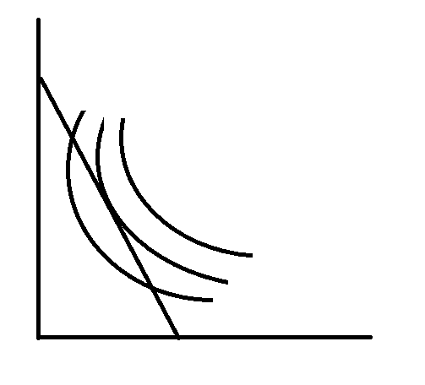
Graphically,
Here AB is the given budget line of the consumer. In the above Indifference Map. Points C and D are the intersection points of AB and IC₁, these points even can’t fulfill the necessary condition therefore they can’t be the equilibrium points or they are undesirable points. It also suggests that the consumer has possibility to increase the utility in that same given budget. Point E is the point lying on IC₂ and it is also tangent to the budget line AB. So it satisfies both the conditions of equilibrium. Or E is the equilibrium point of the consumer in which the consumer consumes OX units of X and OY units of Y.
Units of Y
A
C
F
Y
E
Even though the consumer want to achieve point F of IC₃ but it is not possible because of limited budget. So point F is unattainable point.
IC₃
D
IC₂
IC₁
B
O
X
Units of X

Slide 35
Income effect and Derivation of Engel Curve
We know that, change in income leads to change in quantity demanded of commodities which also changes the equilibrium point of the consumer. The shift of consumer’s equilibrium point due to change in income is called income effect.
German statistician and economist Ernst Engel derived the graphical relationship between money income and money expenditure on a particular good. Which is called as Engel’s curve.
Edwin Mansfield, “An Engel curve is the relationship between the equilibrium quantity purchased of a good and the level of income.”
Engel curve is derived from income consumption curve (ICC).where ICC is a curve derived from joining different equilibrium points of Income effect.
Engel curve is useful to make study of the expenditure pattern of households towards a commodity.

Slide 36
Income effect may change according to the type of commodities as following:
Positive Income effect:
other things remaining constant if consumption of commodity increases with increase in income and vice versa, it is called as positive income effect. It is the case of normal goods.
In case of normal goods, income elasticity of demand is positive and Engel curve is also positively sloped.

Slide 37
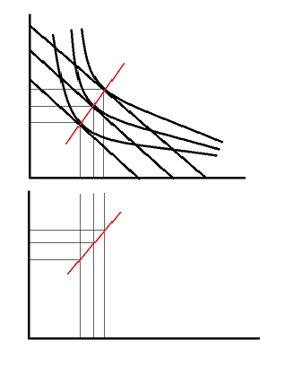
Graphically
Units of Y
A₂
IC₁
IC₂
IC₃
A₁
ICC
A
E₂
E₁
E
E
O
X₁
X₂
X₃
B
B₁
B₂
Units of X
Income
Engel curve
Y₃
Y₂
Y₁
O
X₁
X₂
X₃
Units of X

Slide 38
Negative Income effect:
Other things remaining constant if increase in income of the consumer reduces the consumption of commodity it is called as negative income effect. Income effect is negative in case of inferior goods.
In case of inferior goods, income elasticity of demand is negative and Engel’s curve is also negatively sloped.

Slide 39
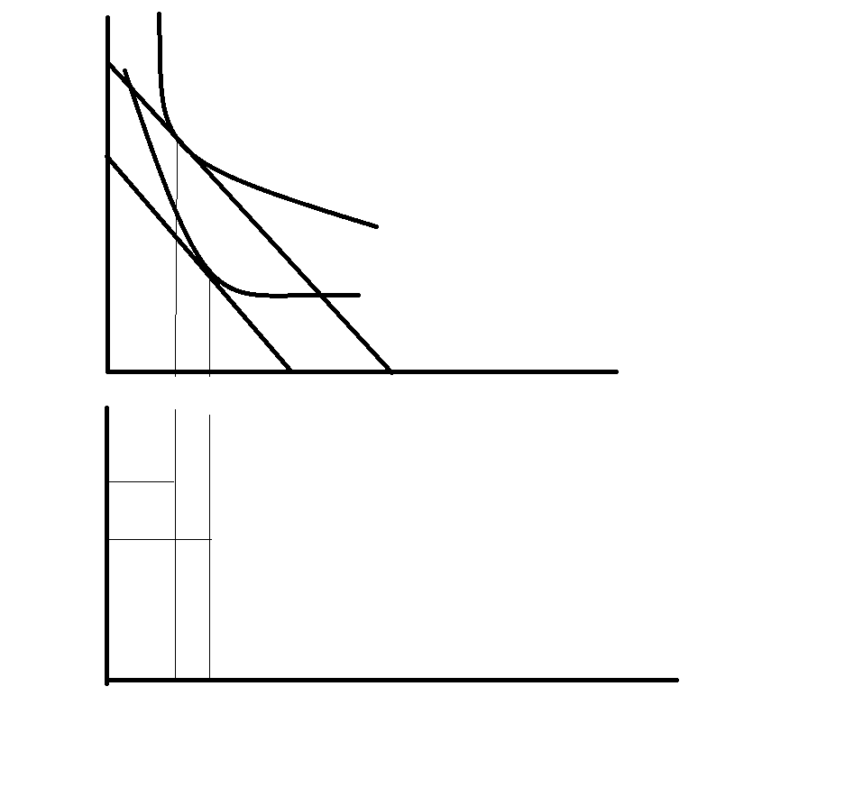
Graphically,
Units of Y
ICC
E₁
IC₂
E
IC₁
O
X₂
X₁
Units of X
Income
Y₂
Y₁
Engel Curve
O
X₂
X₁
Units of X

Slide 40
Zero Income effect:
Other things remaining constant if increase/decrease in income of the consumer has no effect on consumption of commodity it is called as zero income effect. Income effect is zero in case of Neutral goods.
In case of neutral goods, income elasticity of demand is zero and Engel’s curve is parallel to y-axis.
E

Slide 41
Graphically,
Units of Y
A₁
ICC
A
E₂
IC₂
E₁
IC₁
O
B
Units of X
X₁
B₁
Income
Y₂
Engel Curve for Neutral goods X
Y₁
O
Units of X
X₁

Slide 42
Price effect and derivation of demand curve
Similarly as income, consumer’s equilibrium point also shifts from one to another due to change in price of commodity, it is called as price effect.
The consumer gets equilibrium in higher IC when there is decrease in price and in lower IC if there is increase in price.
If we join the different equilibrium points of price effect we get a curve, which is called as Price Consumption Curve (PCC).
The relationship between change in price and quantity demanded of the commodity gives demand curve, so we can derive demand curve from price effect also.
Price effect is negative in case of normal goods and positive in case of giffen goods.

Slide 43
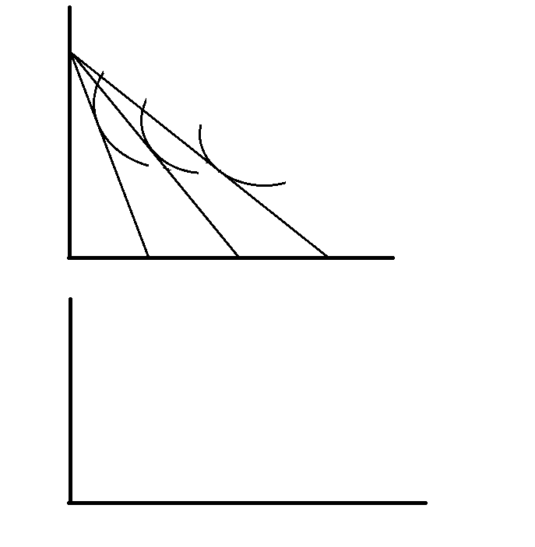
Price effect on normal goods/ if X and Y are substitutes.
Units of Y
A
IC₃
IC₂
Y₁
E₁
IC₁
E₂
Y₂
E₃
Y₃
PCC
B
B’
B’’
O
X₁
X₂
X₃
Units of X
Price
D
A
P₁
P₂
B
P₃
C
D
O
X₁
X₂
X₃
Units of X

Slide 44
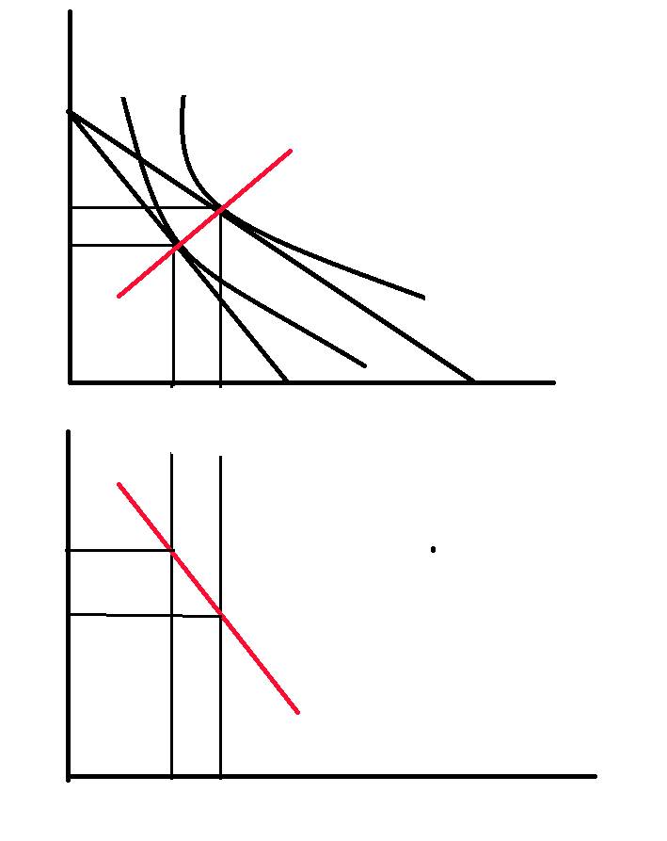
Price effect on normal goods/ if X and Y are Complements .
Units Of Y
IC₁
IC₂
PCC
Y₂
E₂
Y₁
E₁
O
X₁
X₂
Units of X
Price
D
P₁
A
P₂
B
D
O
X₁
X₂
Units of X

Slide 45
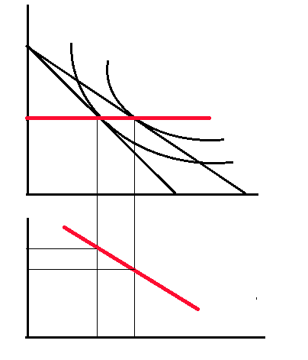
Price effect on normal goods/ if X and Y are non-related goods .
Units of Y
IC₁
A
IC₂
E₁
E₂
PCC
Y
B
B’
Price
O
X₁
X₂
Units of X
D
P₁
A
P₂
B
D
O
X₁
X₂
Units of X

Slide 46
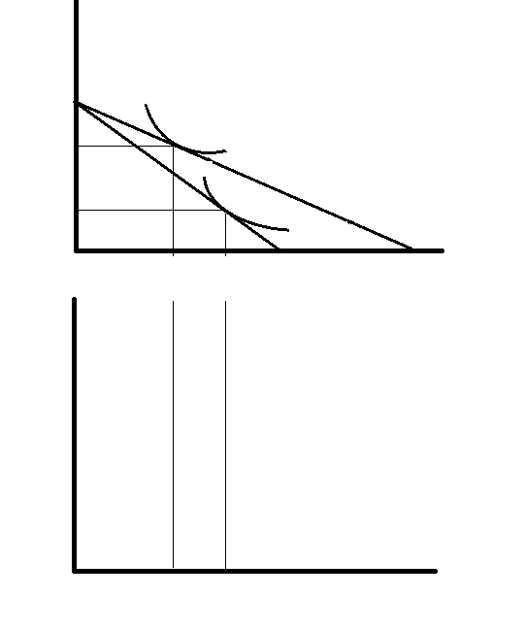
Price effect on Giffen /Veblen goods:
Units of Y
A
PCC
E₁
Y₂
IC₂
Y₁
E
IC₁
O
X₂
X₁
B
B’
Units of X
Price
D
P₁
B
P₂
A
D
O
X₂
X₁
Units of X

Slide 47
Substitution Effect:
Substitution effect is a change in the quantity demanded of a commodity which results from a change in its price, relative to the prices of other commodities.
It is a situation when the relative price of a commodity changes keeping satisfaction level constant the consumer will purchase more units of cheaper goods and less units of expensive goods. Or the consumer substitutes the units of expensive commodity by the units of cheaper commodity, it is called as substitution effect.
Substitution effect is measured by rearranging the purchases made by the consumer as a result of change in the relative prices of goods, satisfaction level and real income remaining constant.

Slide 48
There are two approaches to explain substitution effect:
Hicksian approach:
To measure substitution effect from Hicksian approach, after the change in price of a commodity the consumer’s money income should be compensated in such a way that the consumer will be able to attain same level of satisfaction as previous no matter the consumer is consuming same basket of commodities or not.
It means budget line should be adjusted in such a way that it will be tangent to the initial IC.

Slide 49
Substitution effect and Decomposition of Price effect into income effect and substitution effect: Hicksian Approach :
Here, Initial Equilibrium Point of consumer is E₁ when the Price of X falls, Budget line AB will shift to AB’ and new equilibrium will be formed in IC₂ i.e. E₂.
Therefore, shift of E₁ to E₂ is called price effect .
Units of Y
A
IC₂
When we adjust consumer’s income to CD, keeping same level of satisfaction before price change i.e. at IC₁, new equilibrium point will be formed i.e. E₃.
Therefore shift of E₂ to E₃ is called income effect.
IC₁
C
Y₁
E₁
E₂
Comparing only E₁ and E₃ , the consumer substitutes Y₁Y₂ units of relatively expensive commodity by X₁X₃ units of cheaper commodity to get equal level of satisfaction which is called as Substitution effect.
Y₃
E₃
Here,
Price effect = E₁E₂ = X₁X₂
Income effect = E₂E₃ = X₂X₃
Substitution effect = E₁E₃ = X₁X₃
Since, X₁X₂ = X₂X₃ +X₁X₃
P.E. = I.E. + S.E.
B
B’
O
X₁
X₃
X₂
D
Units of X

Slide 50
Applications of IC analysis:
In determination of the amount of tax and subsidy of the consumers.
To understand the effect of tax and subsidy to the consumers.
To make selection between direct and indirect taxes.
To judge the welfare effects of direct and Indirect taxes.
Income leisure choice of the workers

Slide 51
Criticisms of IC analysis:
Prof. Knight, “IC analysis is not a step forward, it is in fact, a step backward.”
Robertson, “IC is only the old wine in new bottle.”
The main criticisms of IC analysis are:
IC analysis tells nothing new.
It is not easy to indicate the preference.
It cannot be easily extended to more than two goods.
Assumption of transitivity is not always valid.
It is not amenable to empirical tests.
It don’t explain the consumer’s behavior with risk and uncertainty.
IC analysis may look absurd in bulky goods which are indivisible.

Slide 52
Similarities Between the Two Approaches:
(i) Rationality assumption: In the two approaches, it is assumed that the consumer behaves rationality for obtaining satisfaction from his expenditure on consumer goods. Marshall uses the term utility, and Hicks satisfaction.
(ii) Proportionality rule: The equilibrium condition of the consumer in both the analysis is the proportionality rule. In cardinal utility analysis , the equilibrium condition of the consumer is:
MU_{a} / P_{a} = MU_{b} / P_{b} = MU_{c} / P_{c} …………. = MU_{n} / P_{n}
In the Hicksian analysis, this ratio of marginal utility has been substituted by marginal rate of substitution is:
MRS_{xy} = P_{x} / P_{y}
(iii) Diminishing MU and MRS: Another similarity between the two types of analysis is that both assume that as the consumer gets more and more of a commodity, there is diminishing satisfaction to the consumer.
(iv) Same conclusion: The cardinal utility analysis and the Hicksian indifference curve analysis both reach at the same conclusion about the consumer behavior. There is nothing new in the indifference approach.

Slide 53
Superiority of Hicksian Indifference Curve Analysis:
Indifference curve technique is scientific and more realistic.
It explains the income effect and price effect:
It studies combination of two goods:
Application of the principle of MRS:
Popularity of indifference curve technique for the analysis of welfare economies

Slide 54
Thank You.

